Slide 1

IOT Car Parking
Sai Kiran
Abhishek Raj
Smart Way to Park Your Car

Slide 2
The Problem :
Long queues to get a print of parking slip
Investing for Man-Power for redirection.
Wasting time in searching for empty slots
Should always remember the Parking floor as well the slot.

Slide 3
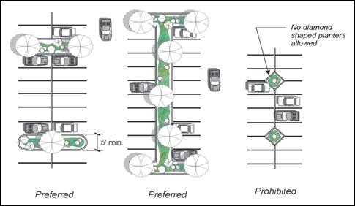




Updated in Server
Sensors sense each slot for availability
User access the website with Free Wi-Fi provided to find the parking slot

Slide 4
At the entrance there would be a Banner saying
To Find a parking slot please visit www.MallWebsite.com
User visits that page ,enters his mobile number and finds the parking slot.
No token or anything required the servers and sensors keep the track of parking time.
User gets updates to mobile if he exceeds the parking time.
As soon as the car is removed from parking slot the server generates a QR code and send it webpage .
At exit point User shows the code to the related person and Bill amount generated is paid by user.

Slide 5
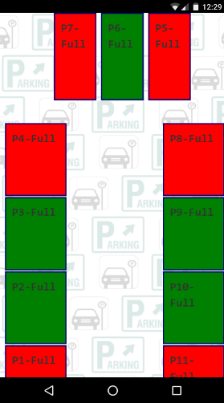
Preview of website(www.MallWebiste.com)
(UI to be improved)

Slide 6
Why an IOT parking System?
Improves security of malls
One time investment.
Low maintenance and least man power.
Go green method no paper tokens.
User Satisfaction is the most important

Slide 7
Queries?

